Slide 1
ENVISION
~ Empirical Data
Visualization App for VIT

Slide 2
TEAM MEMBERS
ANUHKA KHARE - 19BCE10273
01
LAVEENA DUDANI - 19BCE10378
02
ADITI NIGAM - 19BCE10300
03
04
DIVYA MATHEW - 19BCE10456
GUIDED BY : Dr. R Rakesh
REVIEWED BY : Dr. Muneeswaran

Slide 3
01
CONTENTS
INTRODUCTION
Main objective of the project
02
EXISTING WORK
Existing Models
Advantages
limitations of data visualization
03
METHODOLOGY
methodology
Flow Diagram
04
NOVELTY
Main idea of project

Slide 4
05
REAL TIME USAGE
CONTENTS
Real life models and use of concept
06
HARDWARE & SOFTWARE
Hardware and software requirements ?
07
ARCHITECTURE
System Architecture diagram
Architecture diagram
08
LITERATURE REVIEW

Slide 5
09
MODULE DESCRIPTION
CONTENTS
Different modules of the app
10
IMPLEMENATION & CODING
Codes
Inputs and outputs
snapshots
11
DEMO VIDEO
app implementation
12
CONCLUSION

Slide 6

INTRODUCTION
ENVISION aims to provide information to the users regarding different aspects of VIT Bhopal using data visualization. Our app emphasizes the fact that graphical representations of data are more effective for analysis than long textual files. It also helps students get information about their curriculum, credits earned, cgpa and gpa procured by a particular student and teachers of different department. We have tried to achieve transparency by providing a docket of curriculum for each and every branch accessible to all. They could see above information in form of bar charts or pie charts for better analysis

Slide 7

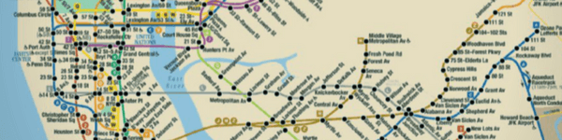
EXISTING MODELS
UBER REQUESTS
SUBWAY MAPS
Data Visualization displays an attractive way of locating the ride and conveying the requests to both party through the interface.
Using data visualization tools this app visualizes the locations in a understandable way for the user .

Slide 8
ADVANTAGES
QUICK & CLEAR
IDENTIFY TRENDS
IDENTIFY PATTERNS
STORYTELLING
ANALYSIS
Data visualization provides us with a quick, clear understanding of the information. We can visualize large volumes of data in an understandable and coherent way This helps us save time and lets us solve problems more efficiently.
Information design helps us identify emerging trends and act quickly based on what we see. Visuals and diagrams make it easier for us to detect highly correlated parameters. Some specific data points must be identified and highlighted to help users focus & influence on decisions they make.
The presentation of info graphics and data enables us to identify relationships and patterns within digital assets, since discerning trends in the data gives us a competitive advantage when it comes to factors that may be affecting product quality, or that may help us solve larger problems.
Data storytelling allows us to develop a new business language so that we can share our story with others. It is a medium that enables us to easily create a narrative through graphics and diagrams, through which, with the help of visual analytics, we can uncover new insights and engage others..
Visualizing data provides us with analysis at various levels of detail. People want evidence of underlying analysis; even if they don’t understand the breakdown of the analytics, they want evidence that there is data behind it, because these stories are more convincing than a mere personal experience.

Slide 9
LIMITATIONS
CONFUSION
02
Visualization that do not have a clear overall logic or the visual format used to represent data may not be universally understandable which can confuse user.
AMBIGUITY
Visual notations may contain unlabeled symbols that may be ambiguous and thus difficult to interpret.
01
HIDING / OBSCURING
03
A visualization may hide important insights contained in data by the way that data is represented graphically.
IMPLICIT MEANING
04
Many visualizations contain allusions that are not fully described or explained and may go unnoticed or may be misinterpreted.
INCONSISTENCY
05
A visualization may make inconsistent use of certain symbols, i.e., changing their function or meaning without signaling this change. It depicts information less precisely than number and tables.

Slide 10
LIMITATIONS
OVER SIMPLIFICATION
07
Some graphic depictions leave out essential elements in order to simplify information which leads to a distortion of the information.
MISLEADING
Some visualization are drawn in a way that may lead to incorrect conclusions.
06
REDUNDANCY
08
In some graphic representations of information, the information is visualized in superfluous ways that clutter the visualization without real need.
TIME CONSUMING
09
Producing a visualization may take a disproportional amount of time for the information that is communicated.
UNEVENNESS
10
A visualization can typically not be used in many different ways. It may privilege some activities while making others harder, thus constraining users’ thoughts in one direction.

Slide 11
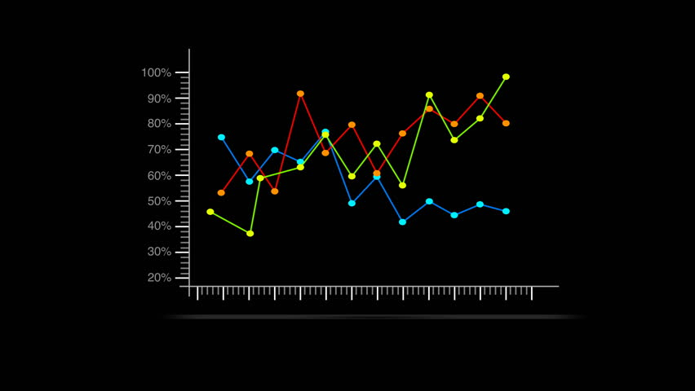
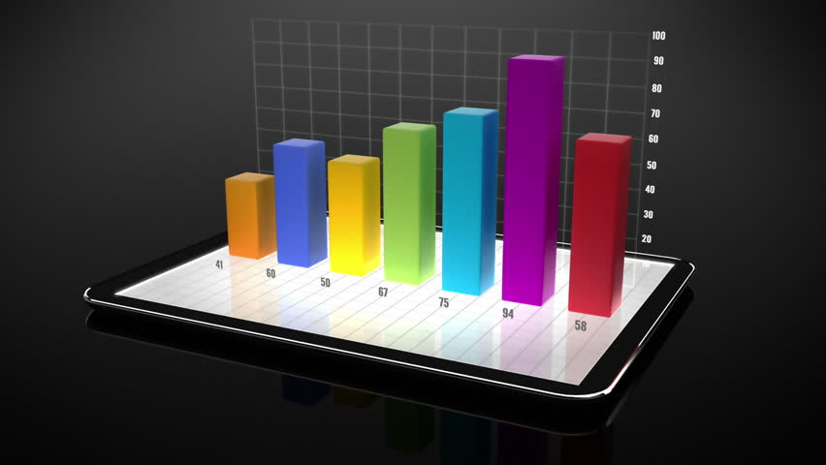
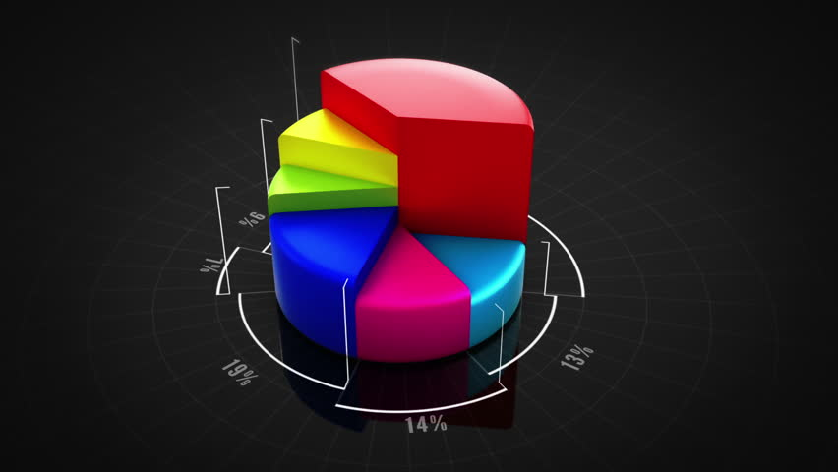
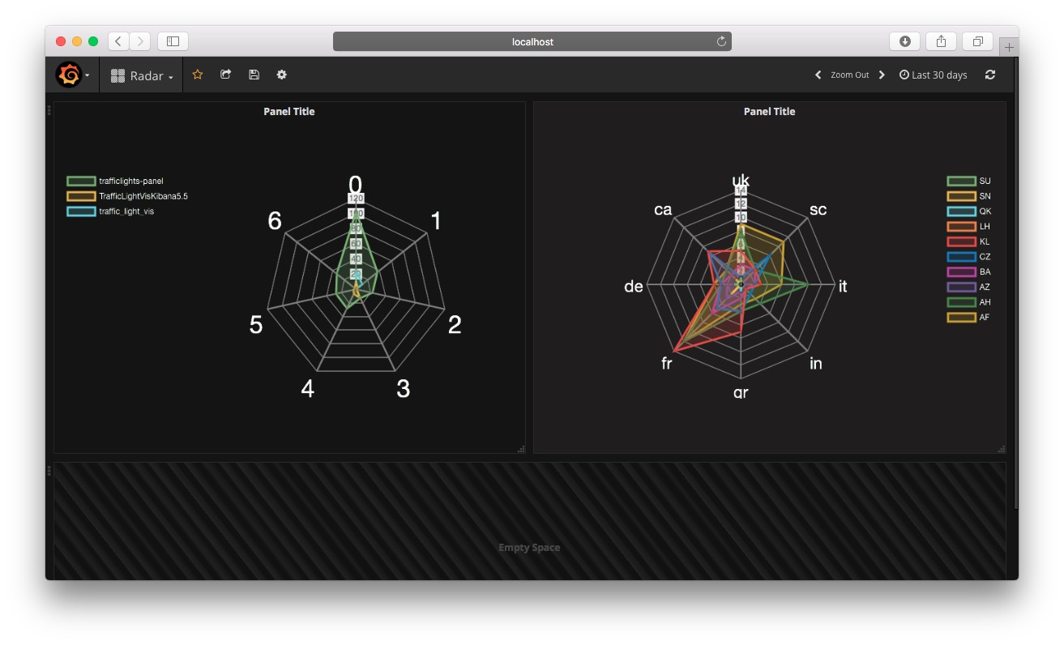
METHODOLOGY
TECHNIQUES
01
02
LINE CHART
BAR CHART
The simplest technique, a line plot is used to plot the relationship or dependence of one variable on another
Bar charts are used for comparing the quantities of different categories or groups. Values of a category are represented with the help of vertical or horizontal bars, with the length or height of each bar representing the value.
04
03
PIE CHART
RADAR CHART
It is a circular statistical graph which decides slices to illustrate numerical proportion. Here the arc length of each slide is proportional to the quantity it represents.
A radar chart is a graphical method of displaying multivariate data in the form of a two-dimensional chart of three or more quantitative variables represented on axes starting from the same point.

Slide 12
FLOW DIAGRAM

Slide 13
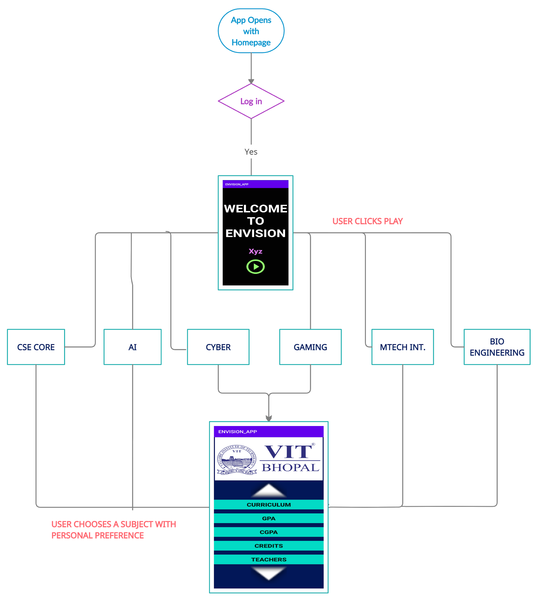

Slide 14
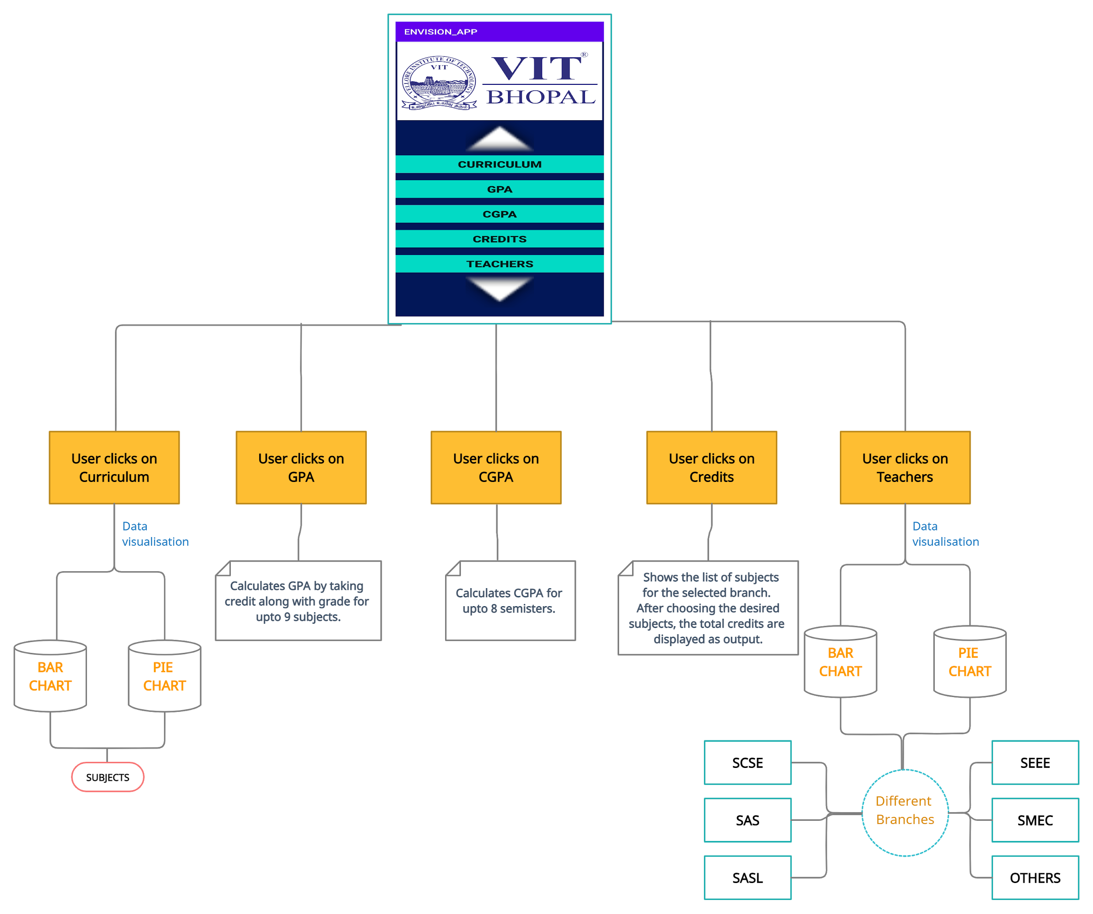
On clicking specific faculty you can get the slots and subjects

Slide 15

ENVISION
Our app aims to provide information to the users regarding different aspects of VIT Bhopal using data visualization. Our app emphasizes the fact that graphical representations of data are more effective for analysis than long textual files. Our app helps students get information about their curriculum, credits earned and teachers of different subjects. They could see this information in various types of graphs of their choice for better analysis.
NOVELTY

Slide 16




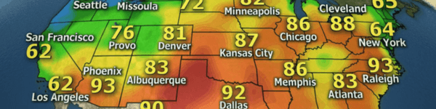
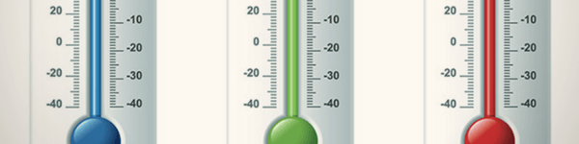


REAL TIME USAGE
TEXTBOOKS
SPEEDOMETERS
CALENDARS
CLOCKS
.
WEATHER MAPS
THERMOMETERS
AUDIO LEVELS
WORKOUT MACHINES
.

Slide 17
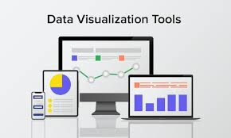
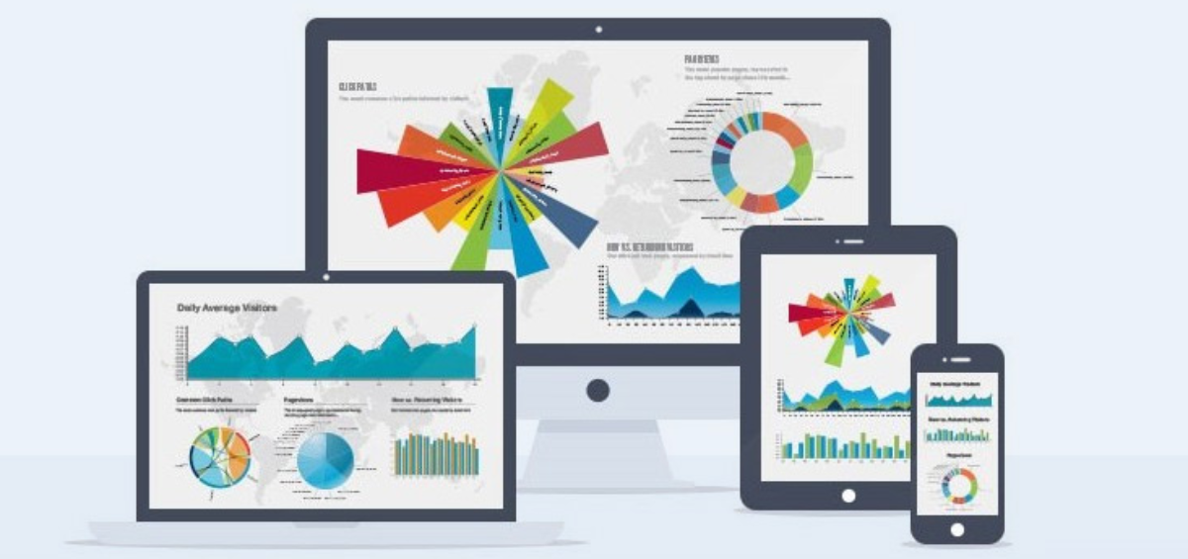
REQUIREMENTS
HARDWARE
Windows 10 64.
Intel Core i7 processors.
Minimum RAM = 8GB.
MAXIMUM RAM= 16GB.
Intel UHD Graphics
128GB SSD.
.
SOFTWARE
ANDROID STUDIO
CHARTING LIBERARY
(MP ANDROID CHART)
DEPENDENCIES
repositories { maven { url "https://jitpack.io" }}
dependencies { implementation 'com.github.PhilJay:MPAndroidChart:v2.2.4'}

Slide 18
SYSTEM ARCHITECTURE
ICONOGRAPHY
Iconography can represent different types of data in a chart and improve a chart’s overall usability and is used for categorical data to differentiate groups or categories.
ZOOMING & PANNING
TYPOGRAPHY
LEGENDS
&
ANNOTATIONS
Zooming and panning are popular chart interactions that affect how closely users can study data and explore the chart UI.
DASHBOARD DESIGN
VISUAL ENCODING
Text can be used to label different chart elements
A dashboard’s purpose should be reflected in its layout, style, and interaction patterns. Its design should suit how it will be used, whether it’s a tool for making a presentation or deeply exploring data.
TEXT WEIGHT
Visual encoding is the process of translating data into visual form. Unique graphical attributes can be applied to both quantitative data and qualitative data
Legends and annotations describe a chart’s information. Annotations should highlight data points, data outliers, and any noteworthy content.
Headings and varying font weights can communicate which content is more (or less) important than other content in the hierarchy.
ELEMENTS
CONTROLS
&
STATES
DEVICE WORKING
Chart titles
Data labels
Axis labels
Legend
filter
Zoom
save
Download
errors
no data
completed
states
danger
On desktop, zoom occurs through clicking and dragging, or scrolling
On mobile, zooms occurs using pinch to zoom
ATTRIBUTES
Shape
Color
Size
Area
Volume
Length
Angle
Position
Direction
Density

Slide 19
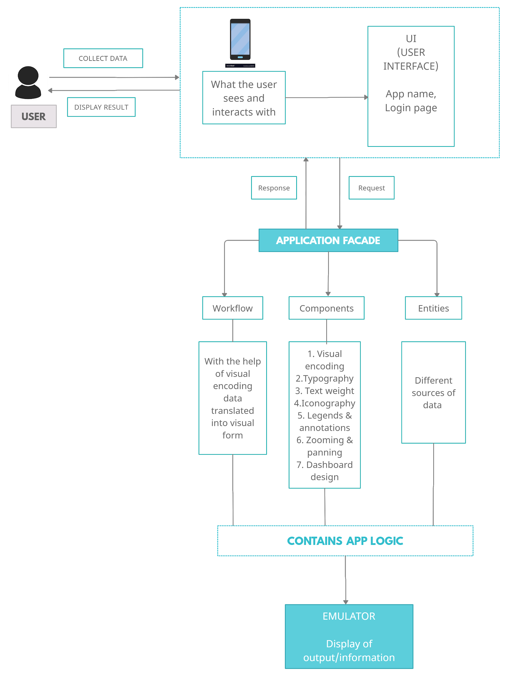
ARCHITECTURE DIAGRAM

Slide 20
LITERATURE
REVIEW
Visualization techniques has been used widely in all the fields. To examine information and data, visualization help in expressing ideas in architecture. With the coming of computer simulation, visualization apposite has been foster notation.
Information visualization concentrates on data sets underlying Two – Dimensional (2D) or Three – Dimensional (3D) substance. For visualization, there are a lot of long – familiar methods for data sets, such as, x-y plots, histograms, and line – plots.
Data visualization covers geographical information systems, graphical user interface, user interface, digital images, graphs, multidimensional tables, virtual reality and three – dimensional advantages.

Slide 21
MODULE DESCRIPTION
CURRICULUM
TEACHERS
MODULES
GPA
CGPA
SEARCH
CREDITS

Slide 22
IMPLEMENATION & CODING
INPUTS & OUTPUTS

Slide 23
BarDataSet barDataSet = new BarDataSet(barEntryArrayList, “SUBJECTS");
barDataSet.setColors(ColorTemplate.COLORFUL_COLORS);
barDataSet.setValueTextSize(20f);
Description description = new Description();
description.setText(“Subjects");
barchart.setDescription(description);
BarData barData = new BarData(barDataSet);
barchart.setData(barData);
// set axis value formater
XAxis xAxis = barchart.getXAxis();
xAxis.setValueFormatter(new IndexAxisValueFormatter(labels));
xAxis.setPosition(XAxis.XAxisPosition.TOP);
xAxis.setDrawGridLines(false);
xAxis.setDrawAxisLine(false);
xAxis.setGranularity(1f);
xAxis.setLabelCount(labels.size());
xAxis.setLabelRotationAngle(270);
barchart.animateY(2000);
barchart.invalidate();
CURRICULUM
This integrant displays the lists of subjects for the opted course according to the student branch i.e core or cyber or gaming etc. in form of bar chart.
USE OF DATA VISUALIZATION IN THE COMPONENT :
BARCHART -
import com.github.mikephil.charting.charts.BarChart;

Slide 24
pieChart = findViewById(R.id.pieChart);
setupPieChart();
loadPieChartData();}
private void setupPieChart() {
pieChart.setDrawHoleEnabled(true);
pieChart.setUsePercentValues(false);
pieChart.setEntryLabelTextSize(16);
pieChart.setEntryLabelColor(Color.BLACK);
pieChart.setCenterText(“SUBJECTS");
pieChart.setCenterTextSize(24);
pieChart.getDescription().setEnabled(false);
Legend l = pieChart.getLegend();
l.setVerticalAlignment(Legend.LegendVerticalAlignment.TOP);
l.setHorizontalAlignment(Legend.LegendHorizontalAlignment.RIGHT);
l.setOrientation(Legend.LegendOrientation.VERTICAL);
l.setDrawInside(false);
l.setEnabled(true);}
private void loadPieChartData() {
ArrayList<PieEntry> entries = new ArrayList<>();
CURRICULUM
This integrant displays the lists of subjects for the opted course according to the student branch i.e core or cyber or gaming etc. in form of pie chart.
USE OF DATA VISUALIZATION IN THE COMPONENT :
PIE CHART -
import com.github.mikephil.charting.charts.PieChart;

Slide 25
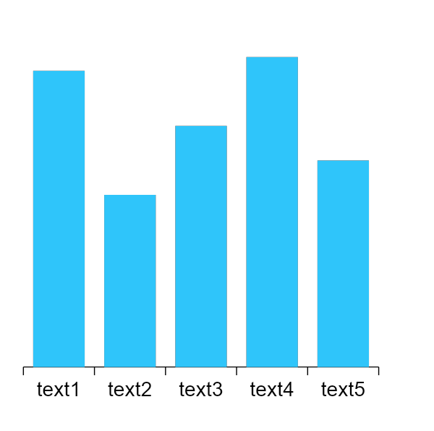
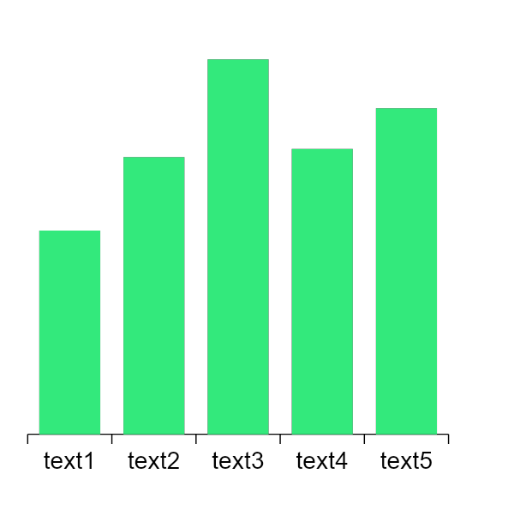
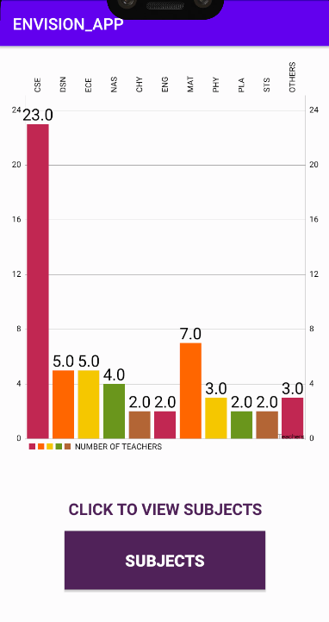
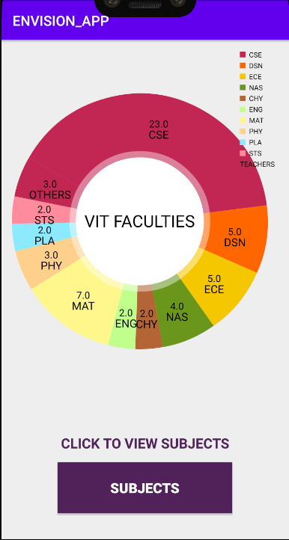
OUTPUT
OUTPUT FOR BAR CHART
OUTPUT FOR PIE CHART

Slide 26
CODE:-
GPA
int N1=0;
if(t15.getText().toString().equals("S")) { N1=10; }
if(t15.getText().toString().equals("A")) { N1=9; }
if(t15.getText().toString().equals("B")) { N1=8; }
if(t15.getText().toString().equals("C")) { N1=7; }
if(t15.getText().toString().equals("D")) { N1=6; }
if(t15.getText().toString().equals("E")) { N1=5; }
if(t15.getText().toString().equals("F")) { N1=0; }
if(t15.getText().toString().equals("N")) { N1=0; }
int num1 =N1*Integer.parseInt(t1.getText().toString());
float y = Integer.parseInt(t9.getText().toString()) +Integer.parseInt(t8.getText().toString()) +Integer.parseInt(t7.getText().toString()) +Integer.parseInt(t6.getText().toString()) +Integer.parseInt(t5.getText().toString()) +Integer.parseInt(t4.getText().toString()) +Integer.parseInt(t3.getText().toString()) +Integer.parseInt(t2.getText().toString()) +Integer.parseInt(t1.getText().toString());
float z=(num1+ num2+ num3+ num4+ num5+ num6+ num7+ num8+ num9);
float x =z/y;
tv.setText(Float.toString(x));
This integrant calculates the GPA of the student of a particular semester.
This integrant contains the information about the faculties branch i.e. whether a particular faculty is from SCSE or SASL or SEEE.
CALCULATION:
In this application, we enter the credits of each subject of that particular semester and the grade achieved in those subjects and the GPA of that semester is displayed as output.
GPA = Sum of ( course credit * grade point ) / sum of credits

Slide 27
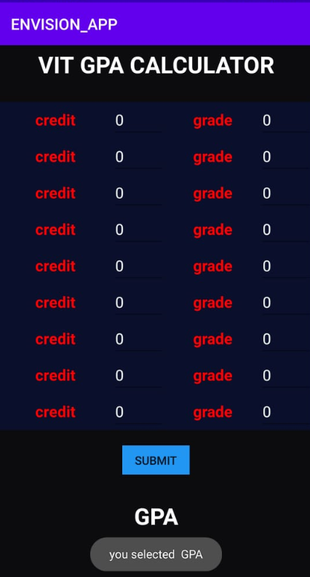
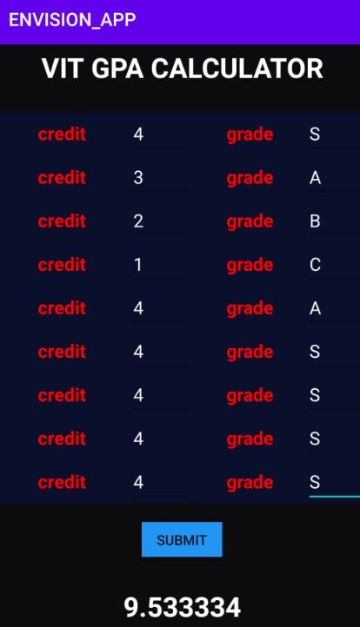
OUTPUT
Graphical User Interface
Of GPA
Output
Of
GPA

Slide 28
Float num = (Float.parseFloat(t1.getText().toString()) +Float.parseFloat(t2.getText().toString()) +Float.parseFloat(t3.getText().toString()) +Float.parseFloat(t4.getText().toString()) +Float.parseFloat(t5.getText().toString()) +Float.parseFloat(t6.getText().toString()) +Float.parseFloat(t7.getText().toString()) +Float.parseFloat(t8.getText().toString())) / Integer.parseInt(t.getText().toString());
tv.setText(Float.toString(num));
Toast.makeText(MainActivity.this,"Result="+num,LENGTH_SHORT).show();
Log.d("string","Result="+ num);
CGPA
CODE:-
This integrant calculates the CGPA of the student as per the current semester he/she is in.
This integrant contains the information about the faculties branch i.e. whether a particular faculty is from SCSE or SASL or SEEE.
CALCULATION:
In this application, we enter the GPA achieved in each semester and the current CGPA is displayed as output.
CGPA = Sum of GPAs / no of semester completed

Slide 29
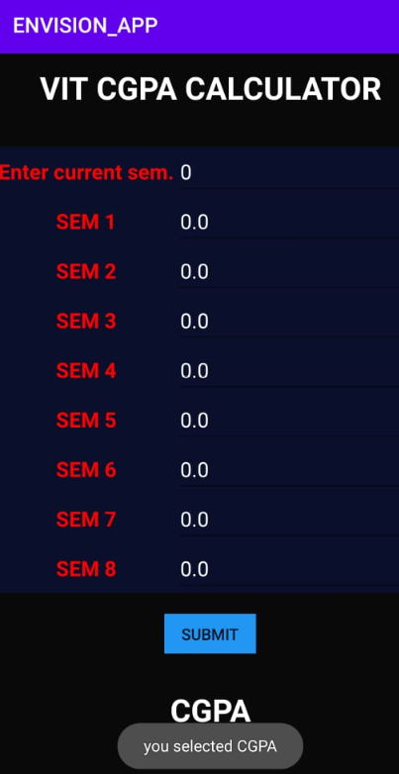
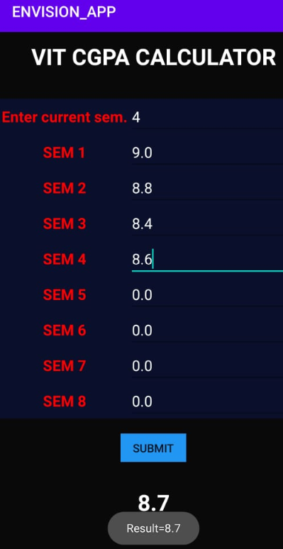
OUTPUT
Graphical User Interface
Of CGPA
Output
Of
CGPA

Slide 30
String s=" ";
int b=0;
if(c.isChecked()) {
tv.setText(c.getText().toString());
s=s+" "+c.getText().toString();
b=b+4; }
if(c1.isChecked()) {
tv.setText(c1.getText().toString());
s=s+" "+c1.getText().toString();
b=b+4; }
tv.setText(s);
tv1.setText(Integer.toString(b));
CREDITS
CODE:-
This integrant calculates the number of credits earned by a student of a particular branch.
This integrant contains the information about the faculties branch i.e. whether a particular faculty is from SCSE or SASL or SEEE.
CALCULATION:
In this application, we select subjects from the docket of curriculum and the total credits is displayed as output.
Total credits = sum of credits earned in each subject.

Slide 31
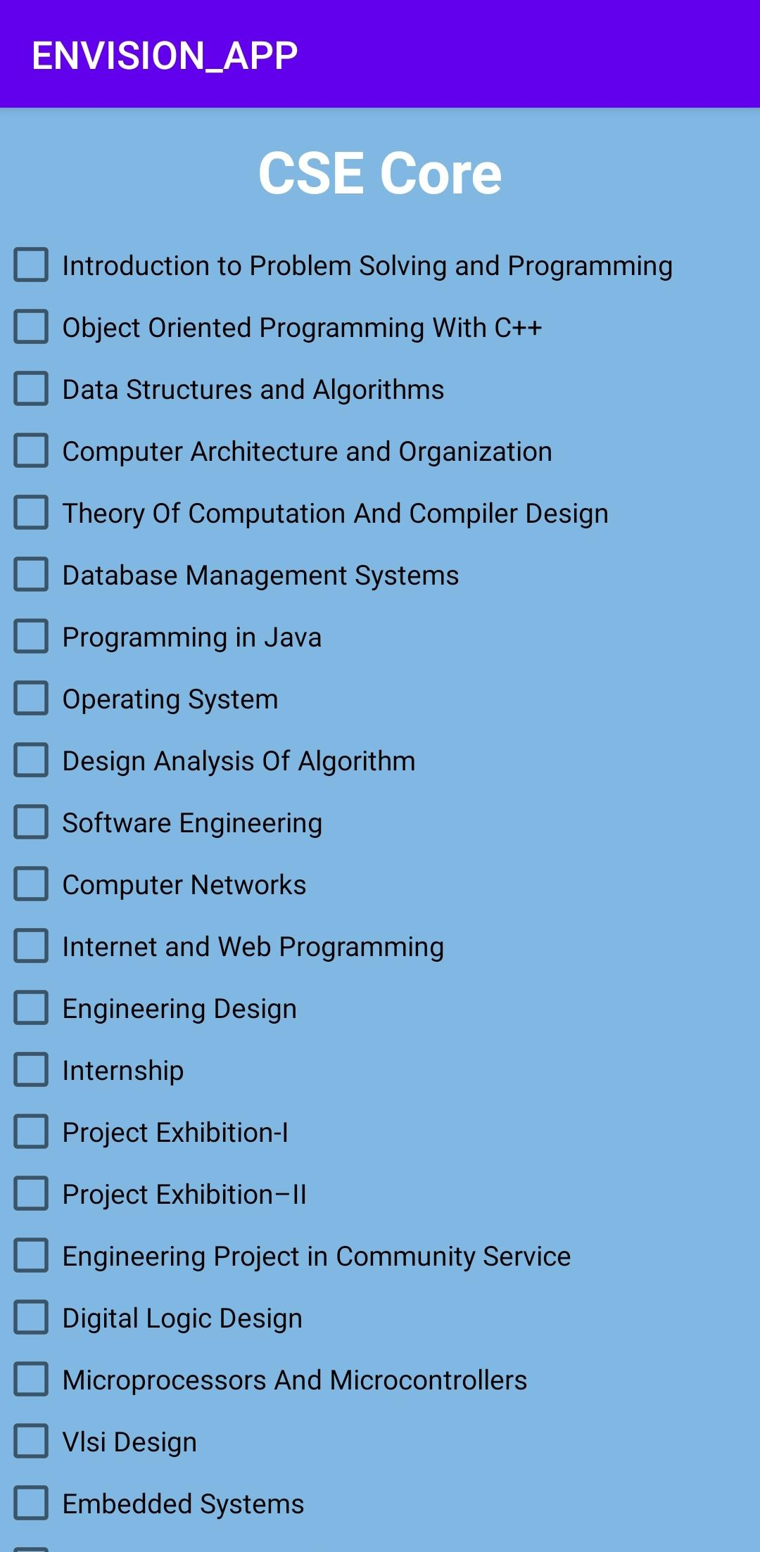
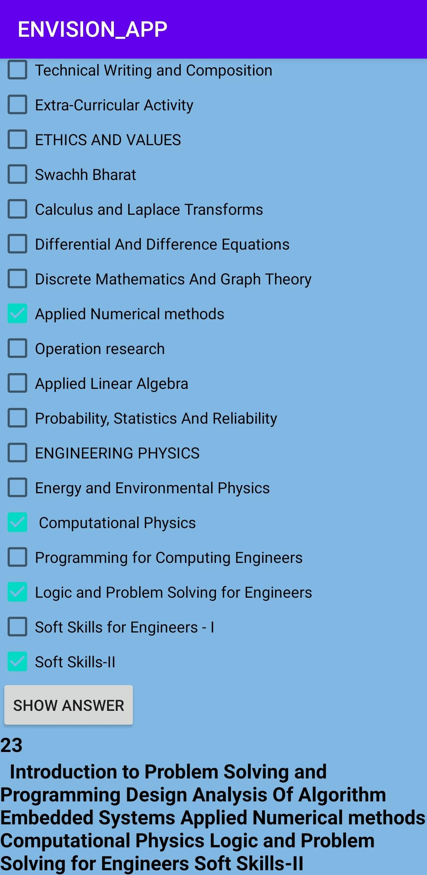
OUTPUT
Graphical User Interface
Of Credits
Output
of Total Credits

Slide 32
CODE :-
BarDataSet barDataSet = new BarDataSet(barEntryArrayList, "NUMBER OF TEACHERS");
barDataSet.setColors(ColorTemplate.COLORFUL_COLORS);
barDataSet.setValueTextSize(20f);
Description description = new Description();
description.setText("Teachers");
barchart.setDescription(description);
BarData barData = new BarData(barDataSet);
barchart.setData(barData);
// set axis value formater
XAxis xAxis = barchart.getXAxis();
xAxis.setValueFormatter(new IndexAxisValueFormatter(labels));
//set position of labels
xAxis.setPosition(XAxis.XAxisPosition.TOP);
xAxis.setDrawGridLines(false);
xAxis.setDrawAxisLine(false);
TEACHERS
This integrant contains the information about the faculties branch i.e. whether a particular faculty is from SCSE or SASL or SEEE.
This integrant contains the information about the faculties branch i.e. whether a particular faculty is from SCSE or SASL or SEEE in form of bar chart.
USE OF DATA VISUALIZATION IN THE COMPONENT :
BARCHART -
import com.github.mikephil.charting.charts.BarChart;

Slide 33
pieChart = findViewById(R.id.pieChart);
setupPieChart();
loadPieChartData();}
private void setupPieChart() {
pieChart.setDrawHoleEnabled(true);
pieChart.setUsePercentValues(false);
pieChart.setEntryLabelTextSize(16);
pieChart.setEntryLabelColor(Color.BLACK);
pieChart.setCenterText("VIT FACULTIES");
pieChart.setCenterTextSize(24);
pieChart.getDescription().setEnabled(false);
Legend l = pieChart.getLegend();
l.setVerticalAlignment(Legend.LegendVerticalAlignment.TOP);
l.setHorizontalAlignment(Legend.LegendHorizontalAlignment.RIGHT);
l.setOrientation(Legend.LegendOrientation.VERTICAL);
l.setDrawInside(false);
l.setEnabled(true);}
private void loadPieChartData() {
ArrayList<PieEntry> entries = new ArrayList<>();
TEACHERS
This integrant contains the information about the faculties branch i.e. whether a particular faculty is from SCSE or SASL or SEEE in form of pie chart.
USE OF DATA VISUALIZATION IN THE COMPONENT :
PIE CHART -
import com.github.mikephil.charting.charts.PieChart;

Slide 34
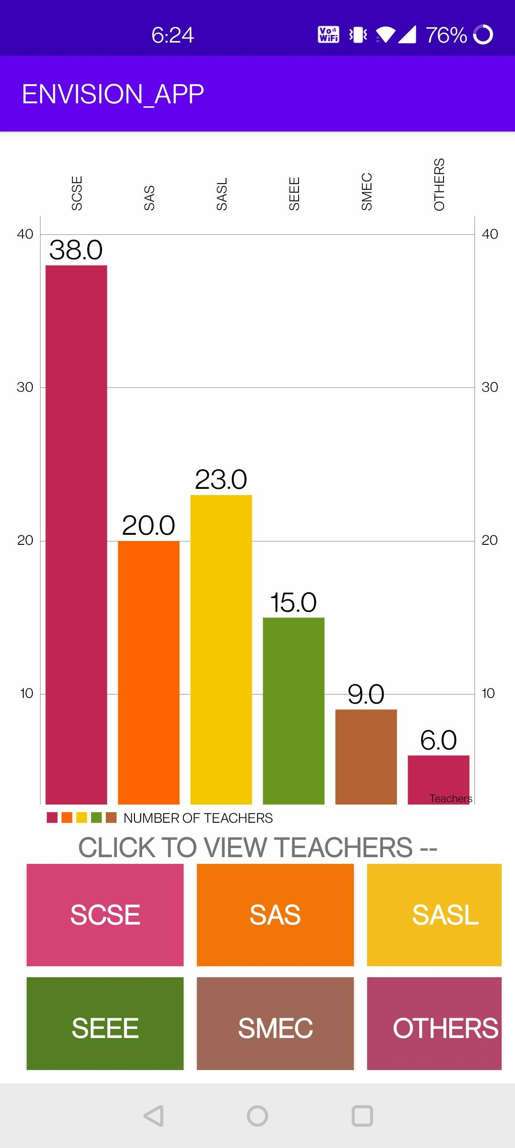
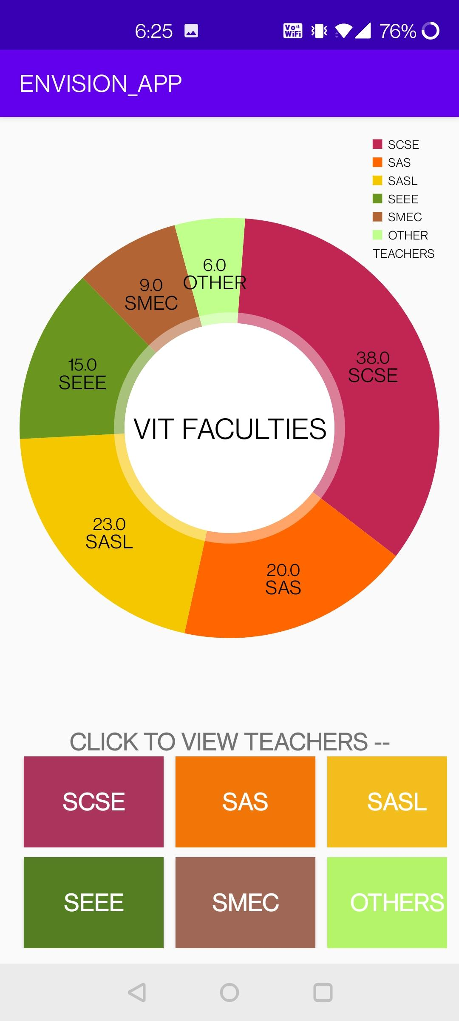
OUTPUT
OUTPUT FOR BAR CHART
OUTPUT FOR PIE CHART

Slide 35
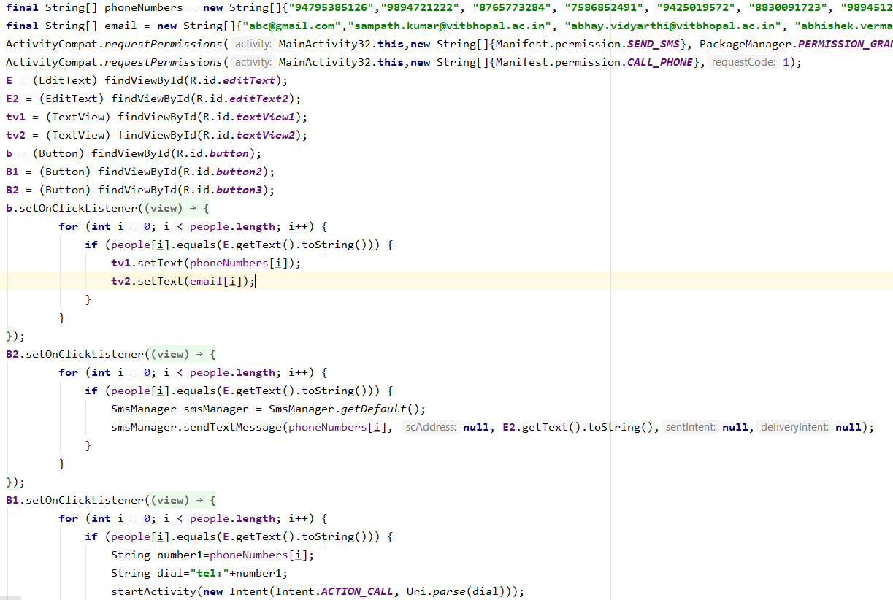
SEARCH
This integrant contains the information about the faculties details i.e. email id and contact number. And also the student can call and message the faculty directly
USE OF DATA VISUALIZATION IN THE COMPONENT :
<uses-permission android:name="android.permission.SEND_SMS" /> <uses-permission android:name="android.permission.CALL_PHONE"/>

Slide 36
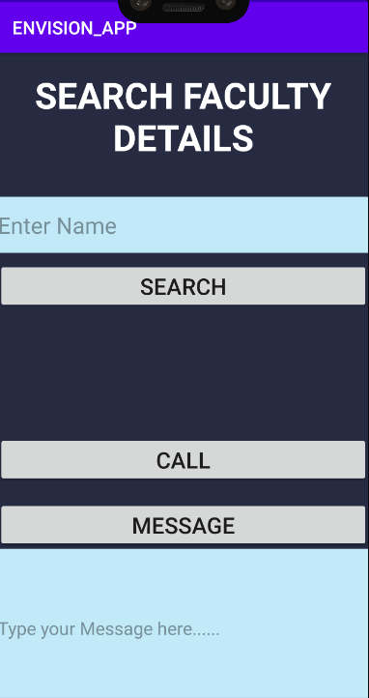
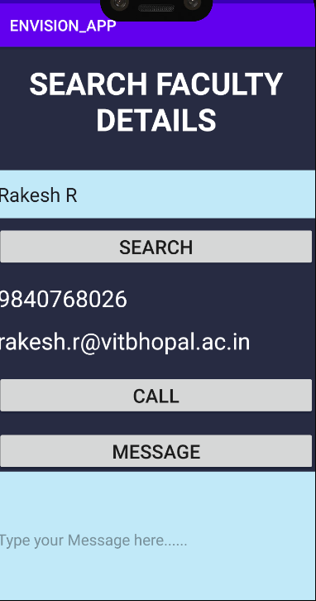
OUTPUT
Output
Of
FACULTY DETAILS
Graphical User Interface
Of SEARCH

Slide 37

DEMO VIDEO
Infographic Style

Slide 38
CONCLUSION
This report started with a brief introduction of data visualization including the objectives and brief of existing work.
Later we discussed about our proposed work which consisted of our proposed approach on ENVISION app and the methodology used.
We also discussed the software hardware used for bringing the idea into practical work and its advantages.
A detailed explanation of how data visualization works on ENVISION was given through codes, an architecture diagram and GUI of our program.
At last, we have concluded with the limitations of our work and scope of data visualization in future.

Slide 39
THANK YOU

